Slide 1
Unit-3
CS44 Data Communications and Networking

Slide 2
Outline of Unit-3
Network Layer: Internet Protocol Version 4
IPv4 Addressing
Main and Auxiliary protocols
Routing Algorithms:
Distance-Vector(DV) Routing
Link-State Routing
Unicast Routing Protocols
Internet Structure
Routing Information Protocol
Open Shortest Path First
Border Gateway Protocol version 4

Slide 3
Internet Protocol Version
two versions
IP Version 4 (IPv4) - almost depleted
IP Version 6 (IPv6)
Internet address or IP address - identifier used in IP layer of the TCP/IP protocol suite to identify the connection of each device to the Internet
IPv4 address is a 32-bit address
Unique - If a device has two connections to the Internet, via two networks, it has two IPv4 addresses
universal - the addressing system must be accepted by any host that wants to be connected to the Internet
the address of the connection, not the host or the router
because if the device is moved to another network, the IP address may be changed

Slide 4
Address space
total number of addresses used by the protocol
If a protocol uses b bits to define an address, the address space is 2^b because each bit can have two different values (0 or 1).
IPv4 uses 32-bit addresses, which means that the address space is 2^32 or 4,294,967,296 (more than 4 billion).
If there were no restrictions, more than 4 billion devices could be connected to the Internet.

Slide 5
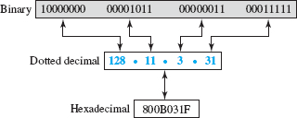
Notation
binary notation (base 2) - displayed as 32 bit.
To make the address more readable, one or more spaces are usually inserted between each octet (8 bits).
Each octet is often referred to as a byte
dotted-decimal notation (base 256) - usually written in decimal form with a decimal point (dot) separating the bytes
each byte (octet) is only 8 bits, each number in the dotted-decimal notation is between 0 and 255
hexadecimal notation (base 16)
Each hexadecimal digit is equivalent to 4 bits. This means that a 32-bit address has eight hexadecimal digits

Slide 6
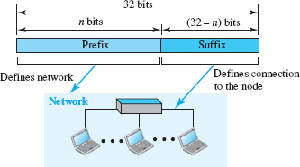
Hierarchy in Addressing
any communication network that involves delivery - the addressing system is hierarchical
32-bit IPv4 address - hierarchical but is divided only into two parts
Prefix-defines the network (n-bits)
fixed length -classful addressing - obsolete
variable length-classless addressing-
Address (suffix) - the node - connection of a device to the Internet (32-n bits)
Notes:
The network identifier
in the IPv4 was first designed as a fixed-length prefix. This scheme, which is
now, is referred to as. The new scheme, which
is referred to as, uses a variable-length network prefix.
First, we briefly discuss classful addressing; then we concentrate on
classless addressing.

Slide 7
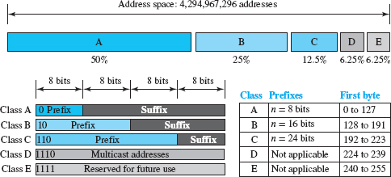
Classful Addressing
to accommodate both small and large networks, three fixed-length prefixes were designed instead of one (n = 8, n = 16, and n = 24)
The whole address space was divided into five classes (classes A, B, C, D, and E)
helps us to understand classless addressing.

Slide 8
Classful Addressing cont…
class A - network length is 8 bits but because the first bit is 0, we can have only 7 bits as the network identifier.
2⁷ = 128 networks in the world
class B - the network length is 16 bits, but because the first 2 bits are (10)₂, we can have only 14 bits as the network identifier
2¹⁴ = 16,384 networks in the world
class C - network length is 24 bits but because the first 3 bits are (110)₂ we can have only 21 bits as the network identifier.
2²¹ = 2,097,152networks in the world
Class D is not divided into prefix and suffix. It is used for multicast addresses
class E -All addresses that start with 1111 in binary belong to.
As in class D, class E is not divided into prefix and suffix and is used as reserve.
Notes:
In.
All addresses that start with (110)2 belong to class C. In class C, the
network length is 24 bits, but because 3 bits define the class, we can have
only 21 bits as the network identifier. This means there are 221 = 2,097,152
networks in the world that can have a class C address.
Class D is not divided into prefix and suffix. It is used for multicast
addresses. All addresses that start with 1111 in binary belong to class E. As
in class D, class E is not divided into prefix and suffix and is used as
reserve.

Slide 9
Address Depletion
the addresses were not distributed properly so the Internet was faced with the problem of the addresses being rapidly used up, resulting in no more addresses being available for organizations and individuals that needed to have an Internet connection.
Eg. class A -assigned to only 128 organizations in the world, but each organization would need to have one single network (seen by the rest of the world) with 16,777,216 nodes (computers in this single network).
Because there were only a few organizations that are this large, most of the addresses in this class were wasted (unused).
Class B addresses were designed for midsize organizations, but many of the addresses in this class also remained unused.
Class C addresses have a completely different design flaw. The number of addresses that can be used in each network (256) was so small that most companies were not comfortable using a block in this address.
Class E addresses were almost never used, wasting the whole class.
larger address space requires the length of IP addresses be increased -means the format of the IP packets needs to be changed (IPv6) - long-range solution
Short term solution – classless addressing (no classes)

Slide 10
Classless Addressing
new architecture announced in 1996 by the Internet authorities
use the same address space but change the distribution of addresses to provide a fair share to each organization
Motivation
Solution to address depletion
Manage Internet Service Providers (ISPs)
During the 1990s, Internet Service Providers (ISPs) came into prominence
An ISP is an organization that provides Internet access and services for individuals, small businesses, and midsize organizations that do not want to create an Internet site and become involved in providing Internet services (such as electronic mail) for their employees.
An ISP is granted a large range of addresses and then subdivides the addresses (in groups of 1, 2, 4, 8, 16, and so on), giving a range of addresses to a household or a small business
connected via a dial-up modem, DSL, or cable modem to the ISP

Slide 11

Classless Addressing
whole address space is divided into non overlapping variable-length blocks - block of 2⁰, 2¹, 2², …, 2³² addresses
restrictions - the number of addresses in a block needs to be a power of 2
An organization can be granted one block of addresses.
prefix in an address defines the block (network)
suffix defines the node (device)

Slide 12

Prefix Length: Slash Notation
how to find the prefix length if an address is given?
Because the prefix length is not inherent in the address, we need to separately give the length of the prefix.
the prefix length, n, is added to the address, separated by a slash.
The notation is informally referred to as slash notation and formally as classless interdomain routing (CIDR, pronounced cider) strategy.

Slide 13
Extracting Information from an Address
Given any address in the block, we normally like to know three pieces of information about the block to which the address belongs:
the number of addresses
the first address in the block -keep the n leftmost bits and set the (32 − n)
the last address- keep the n leftmost bits and set the (32 − n) rightmost bits all to 0s rightmost bits all to 1s
Because the value of prefix length, n, is given, we can easily find these three pieces of information

Slide 14
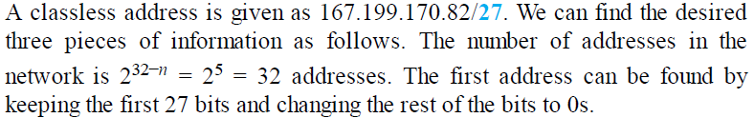
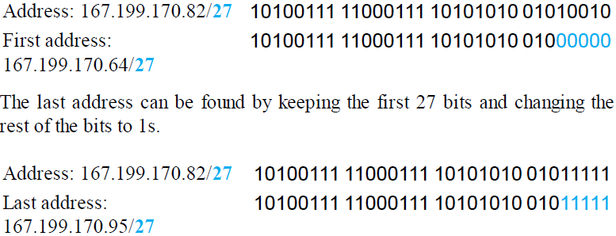
Example 1

Slide 15
Address Mask
Another way to find the first and last addresses in the block is to use the address mask.
The address mask is a 32-bit number in which the n leftmost bits are set to 1s and the rest of the bits (32 − n) are set to 0s.
A computer can easily find the address mask because it is the complement of (2^{32−n} − 1).
The reason for defining a mask in this way is that it can be used by a computer program to extract the information in a block, using the three bitwise operations NOT, AND, and OR.
1. The number of addresses in the block N = NOT (Mask) + 1.
2. The first address in the block = (Any address in the block) AND (Mask).
3. The last address in the block = (Any address in the block) OR [(NOT (Mask)].

Slide 16
Address Mask
repeat Example 1 using the mask. The mask in dotted-decimal notation is 256.256.256.224. The AND, OR, and NOT operations can be applied to individual bytes using calculators and applets at the book website.
Number of addresses in the block: N = NOT (mask) + 1 = 0.0.0.31 + 1 = 32 addresses
First address: First = (address) AND (mask) = 167.199.170. 82
Last address: Last = (address) OR (NOT mask) = 167.199.170. 255

